Slide 1

TOUR & TRAVEL MANAGEMENT SYSTEM

Slide 2

BIET JHANSI
Guided By: Presented By:
Prof. Umakant Ahirwal Shashwat Mishra

Slide 3

DEVELOPERS
SHASHWAT MISHRA

Slide 4
Abstract
The objective of the project is to develop a system that automates the processes and activities of a travel. The purpose is to design a system using which one can perform all operations related to traveling.

Slide 5
Introduction
Tour & Travel is an irresistible word when it comes to tour and travel packages. We offer tour and travel services including ticket bookings, hotel, holiday tour packages, and domestic tour packages. We provide the most suitably designed as well as the customized travel packages to the customers. We offer everything related to travelling services under one roof. Today's extremely exhausting work environment dictates that individuals requires some joyful holiday. We provide stress-free joyful refreshing holidays with cost competitive and customized packages according to their requirements. We provide services in almost each and every city of India. We want to serve our customers with best possible service and provide them the kind of comfort they want.

Slide 6
Introduction (Continue)
We also want to customize our tours as per our customer’s requirement without reducing joy or quality of tour. People of all ages and backgrounds will come to enjoy the unique, upscale, joyful, and refreshing environment that Tour & Travel provides. We provide the transportation through its Airways, Railways and busses. According to the tour packages we provide the facilities to customers such as hotels, guest houses, and rental cars. It may vary from customer to customer and packages according to need. We offer new products and concepts from time to time. Keeping the effect of change of seasons on the human mind and body, we revise our itineraries regularly.

Slide 7
Introduction (Continue)
This is because the comfort and the satisfaction of our customers are paramount to us. Tour & Travel offer a large range of travel opportunities. Whether you're looking for a weekend getaway to relax and indulge, a special holiday with friends and family, a trip to your favorite chill out spot or a new adventure, you've come to the right place. Tour & Travel offers great deals and discounts on flights, railways, hotels, holiday packages, car rental and travel activities everything you need to plan, shop

Slide 8
Problem Definition
In the present system a customer has to approach various agencies to find details of places and to book tickets. This often requires a lot of time and effort. A customer may not get the desired information from these offices and often the customer may be misguided. It is tedious for a customer to plan a particular journey and have it executed properly.

Slide 9
Objective
The project carried out under the title “TOUR & TRAVEL MANEGMENT SYSTEM” is a sincere efforts towards increasing the speed and enhancing the Performance of managing a Private Work. This has been tried to achieve thought making the whole system computerized along with the basic tasks of Private work and automation of all storage network. Certain additional feature like making new user to use this software, better user interaction etc.

Slide 10
Need of The System
There is always a need of a system that will computerize the tour booking and help to find the right tour destination. This system will reduce the manual operation required to maintain all the records of destination tour packages and their bookings. And also generates the various reports for analysis.
Thus, there is a big need of an online tour and travel management system, which provides all the above- mentioned facilities and many more

Slide 11
Project Scope
The project has a wide scope, as it is not intended to a particular organization. This project is going to develop generic software, which can be applied by any businesses organization. More over it provides facility to its users. Also the software is going to provide a huge amount of summary data.

Slide 12
Proposed System
The development of the new system contains the following activities, which try to automate the entire process keeping in view of the database integration approach.
User friendliness is provided in the application with various controls.
The system makes the overall project management much easier and flexible.
There is no risk of data mismanagement at any level while the project development is under process.
It provides high level of security with different level of authentication.

Slide 13
User Modules (Continue):
Destination View: View all available packages.
Searching: User search tour package.
View our booking detail.
View travel blog post.
Change his/ her password

Slide 14
User Modules:
User can login with the valid username and password.
Update his/her profile
Book Tour.
View About Us: This module help the visitor to see the latest About Our Website.
Contact and Feedback: Customer user gives the feedback about our services and send query.

Slide 15
Admin Modules:
Admin can add/update/ delete tour packages.
Admin can add/update/ delete travel blogs.
Admin can also manage the booking application (approve and not approve).
Admin can view all registered users.
Admin can change own password after login.
Admin can also view admin dashboard

Slide 16
SOFTWARE USED
XAMPP(Apache Mysql Php)
NOTEPAD++ OR ANY OTHER TEXT EDITOR
CHROME OR ANY OTHER BROWSER

Slide 17
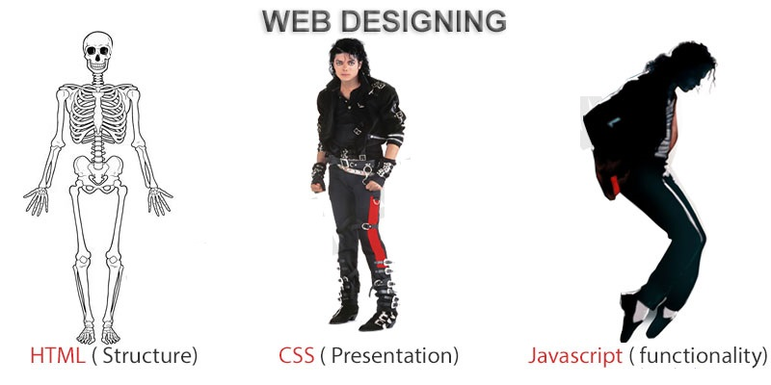
FRONTEND (LANGUAGE USED)
HTML (HYPERTEXT MARKUP LANGUAGE)
CSS (CASCADING STYLE SHEET)
BOOTSTRAP (FRAMEWORK OF CSS AND JS)

Slide 18

BackEnd Technologies Used
PHP(Hypertext Preprocessor)(Server Side Language)
MYSQL(Database)

Slide 19
SYSTEM DESIGN
Unified Modeling Language:
UML stands for Unified Modeling Language. It is a third generation method for specifying, visualizing and documenting the artifacts of an object oriented system under development. Object modeling is the process by which the logical objects in the real world (problem space) are represented (mapped) by the actual objects in the program (logical or a mini world). This visual representation of the objects, their relationships and their structures is for the ease of understanding. This is a step while developing any product after analysis.

Slide 20
The Unified Modeling Language encompasses a number of models.
Use case diagrams
Class diagrams
Sequence diagrams

Slide 21
Use Case Diagram:
Use case diagram consists of use cases and actors and shows the interaction between them. The key points are:
The main purpose is to show the interaction between the use cases and the actor.
To represent the system requirement from user’s perspective.
The use cases are the functions that are to be performed in the module.
An actor could be the end-user of the system or an external system.

Slide 22
Use Case Diagrams – Admin :
Admin Dashboard
ManageDestination
(Add/update/ delete)
Manage Blog Post
(Add / update / delete)
Manage Users
(View / Delete)
Manage Booking requests
(Approve / not approve)
Change Password

Slide 23
Use Case Diagrams User:
Destination Search and Booking
View Booking History
View Blog Post
Change Password
User Profile
(Update)

Slide 24
Sequence Diagram:
The purpose of sequence diagram is to show the flow of functionality through a use case. In other words, we call it a mapping process in terms of data transfers from the actor through the corresponding objects.

Slide 25
SEQUENCE DIAGRAM

Slide 26
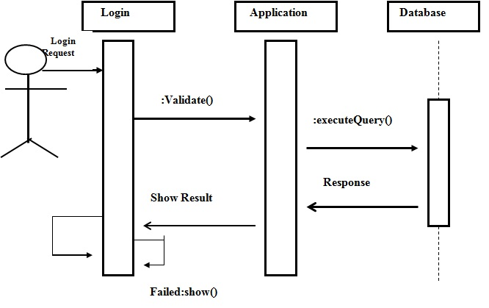
Sequence Diagram For Administrator:-

Slide 27
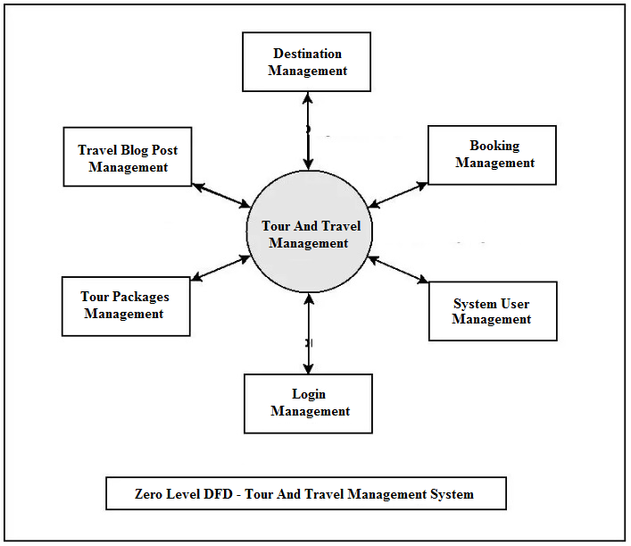
Data Flow Diagram(DFD)

Slide 28
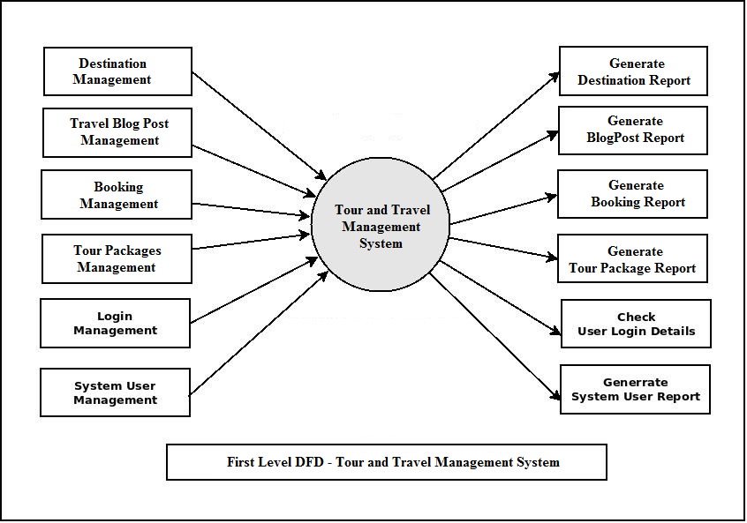
Data Flow Diagram(DFD)

Slide 29
ER Diagram

Slide 30
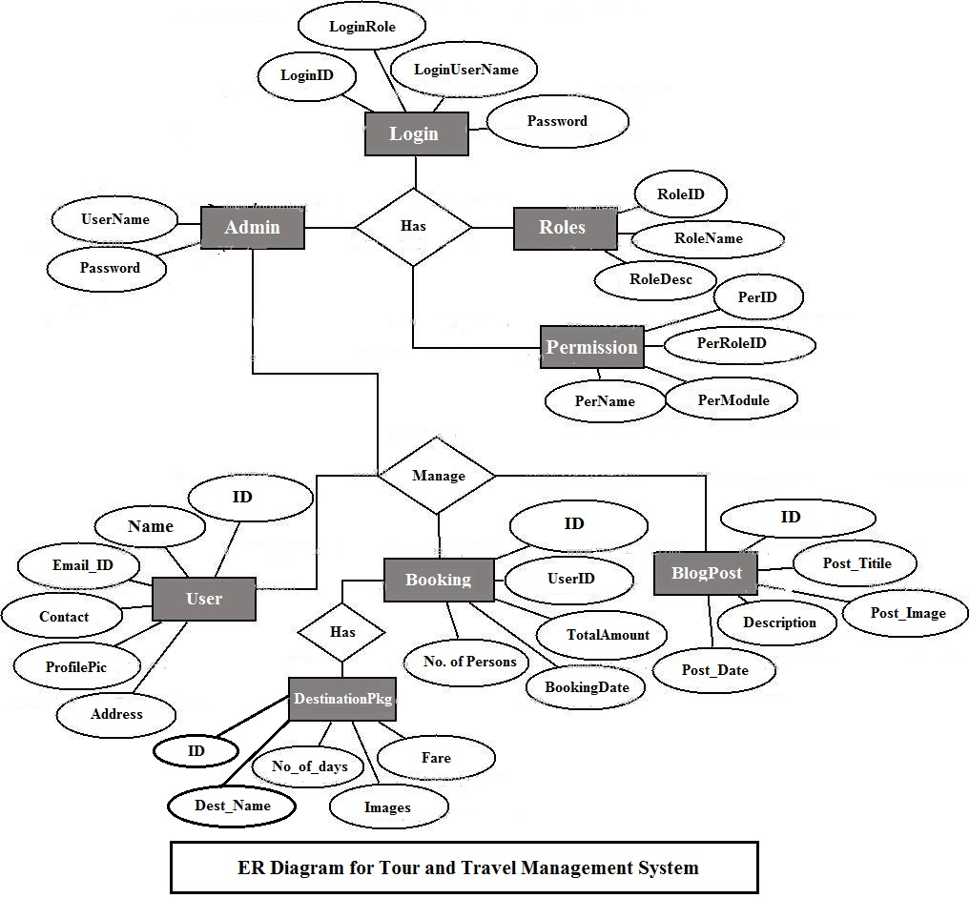

Slide 31
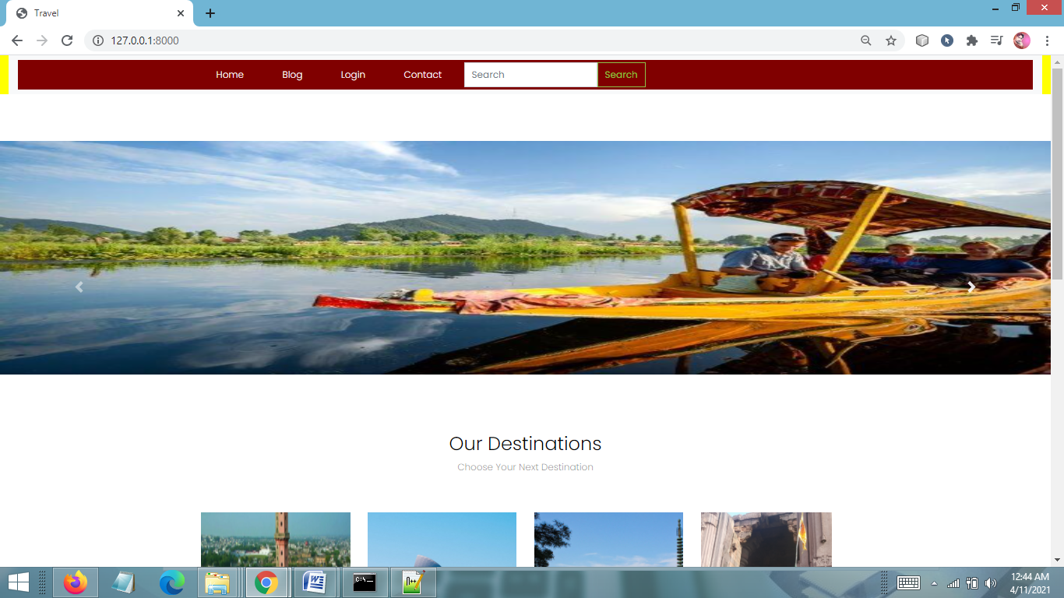
SCREEN SHOTS – Home Page

Slide 32
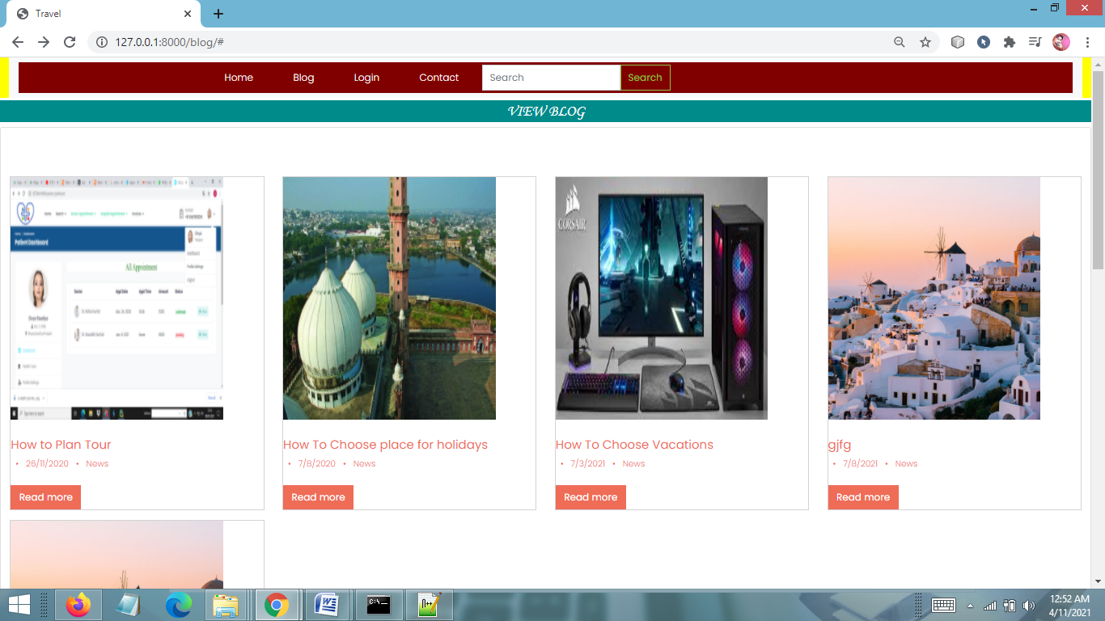
View All Blog Post Page

Slide 33
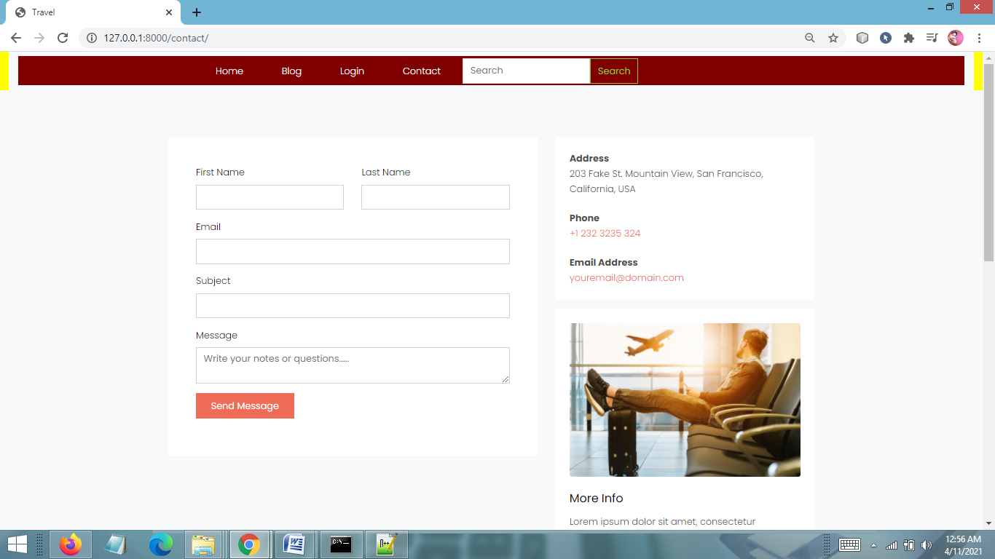
CONTACT US PAGE

Slide 34
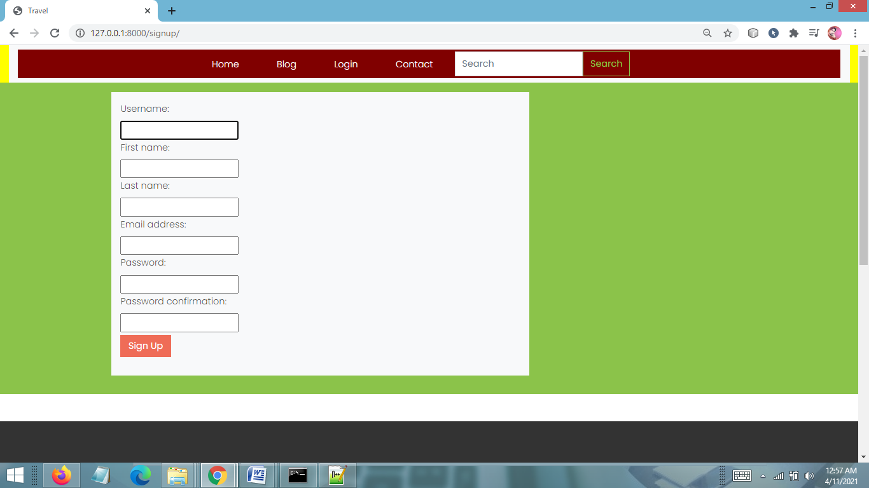
SIGNUP PAGE

Slide 35
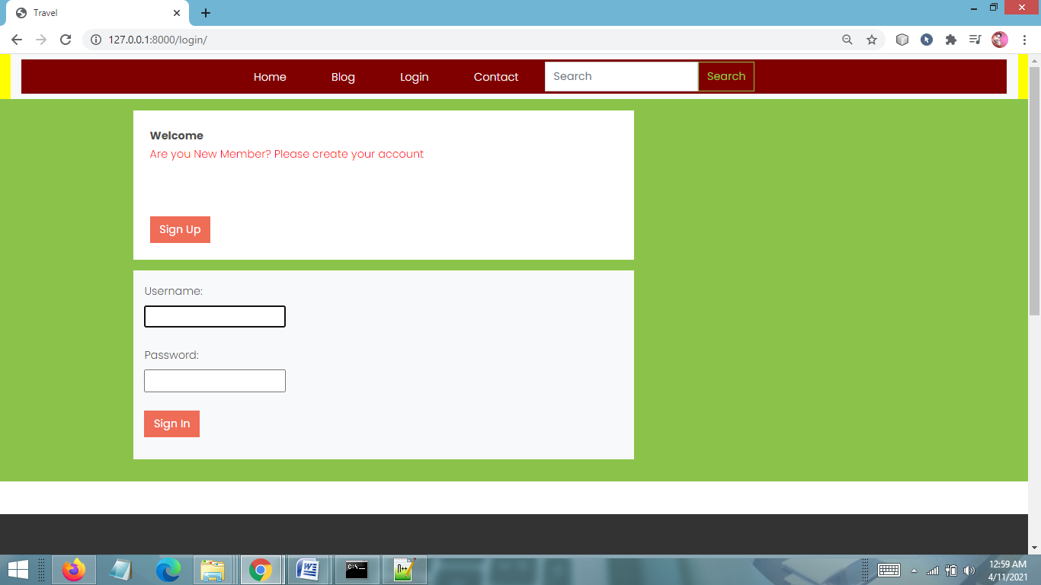
LOGIN PAGE

Slide 36
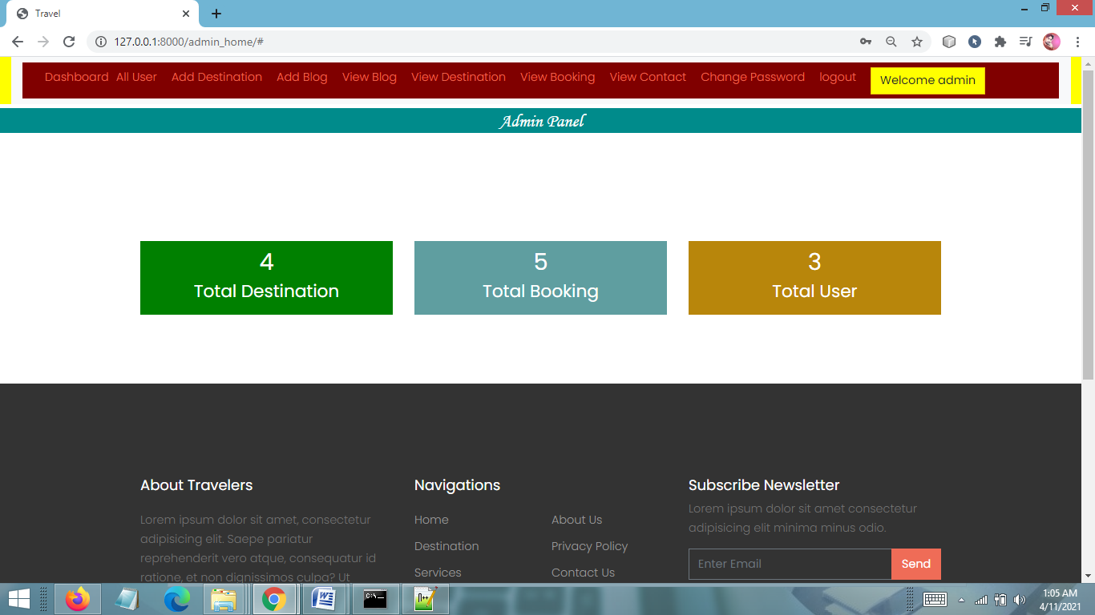
ADMIN HOME PAGE

Slide 37
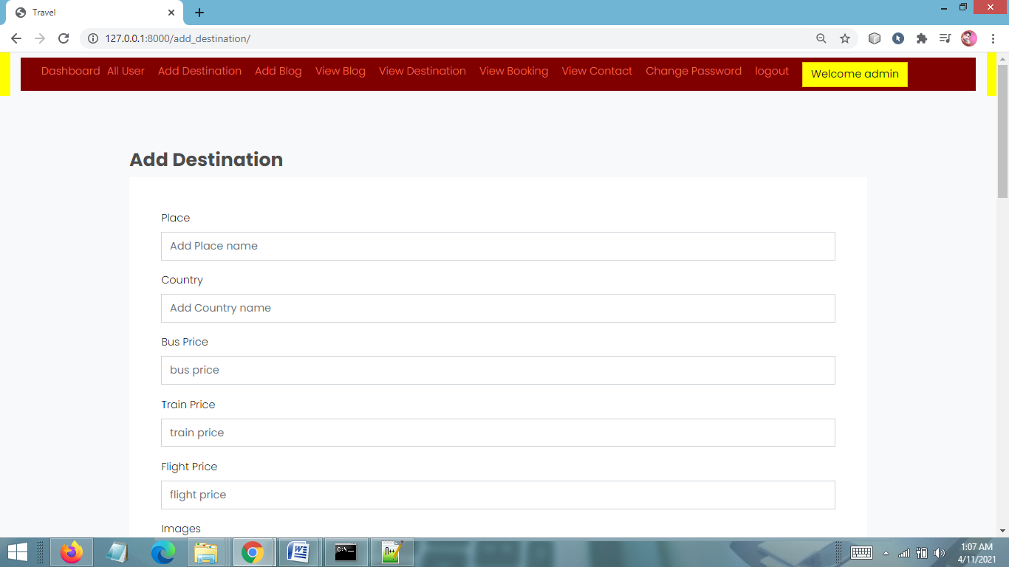
ADD DESTINATION PAGE

Slide 38
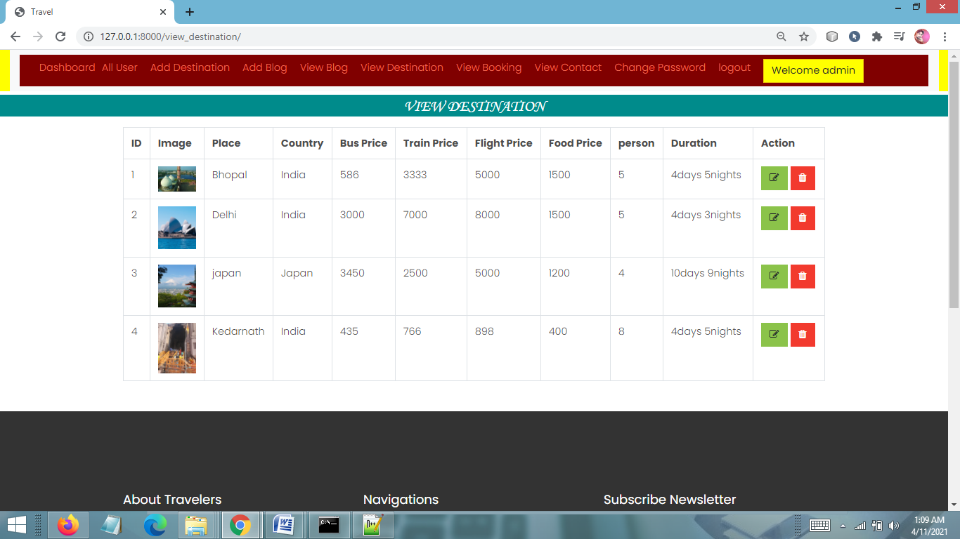
Manage Tour Destination Page

Slide 39
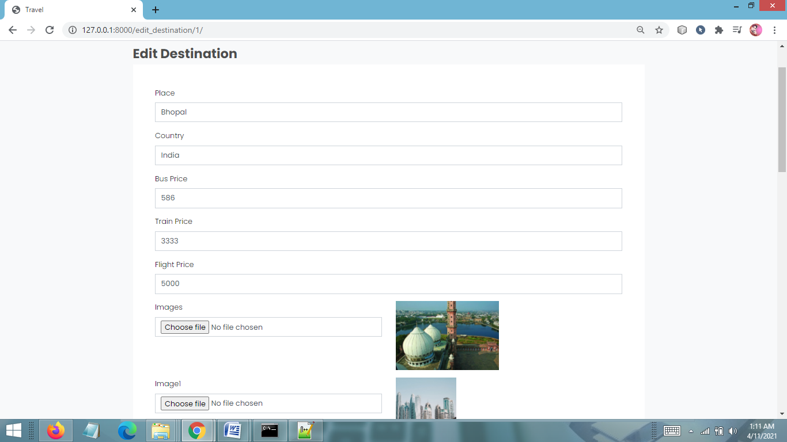
Edit Tour Destination Page

Slide 40
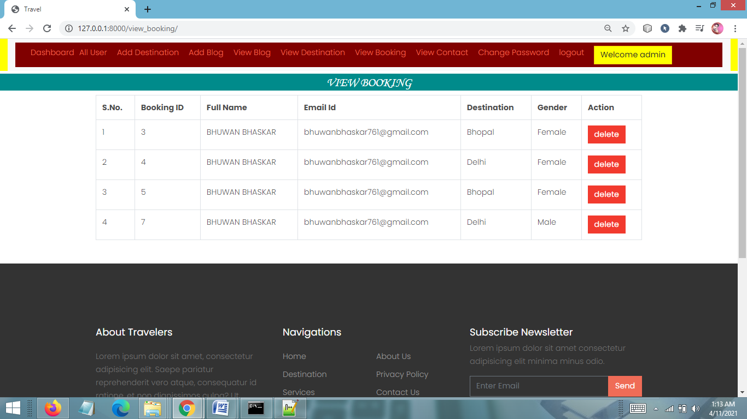
VIEW ALL BOOKING PAGE

Slide 41
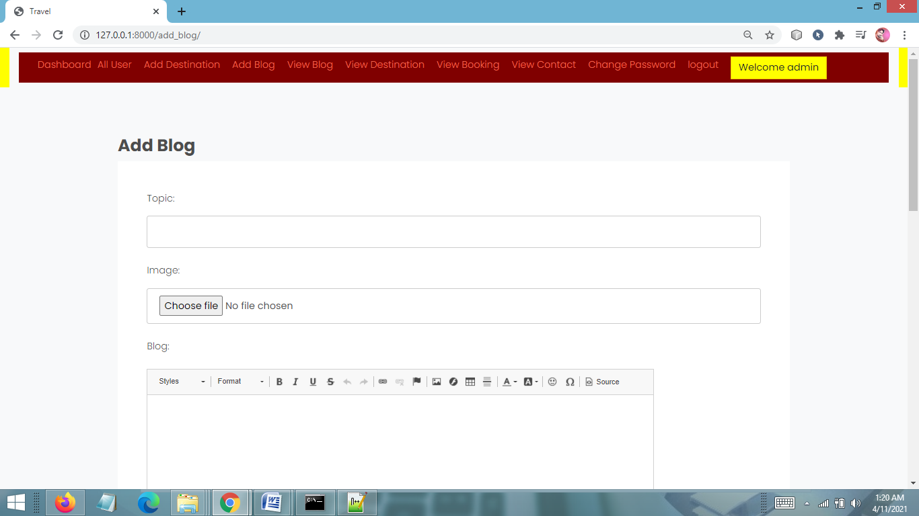
ADD BLOG POST PAGE

Slide 42
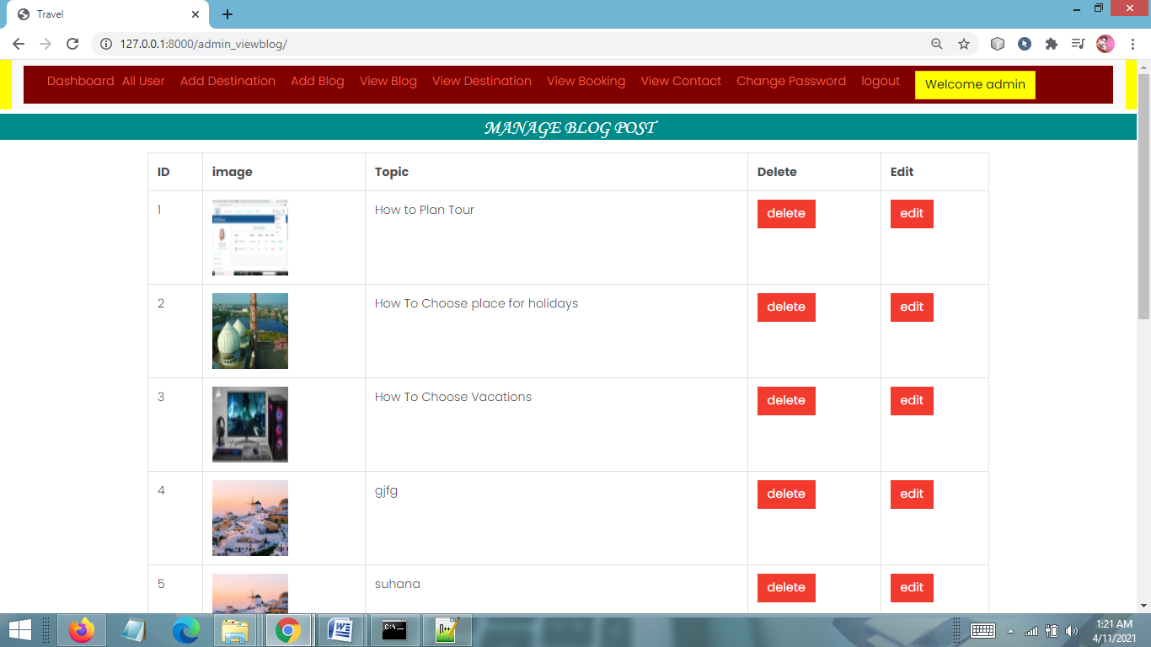
MANAGE BLOG POST PAGE

Slide 43
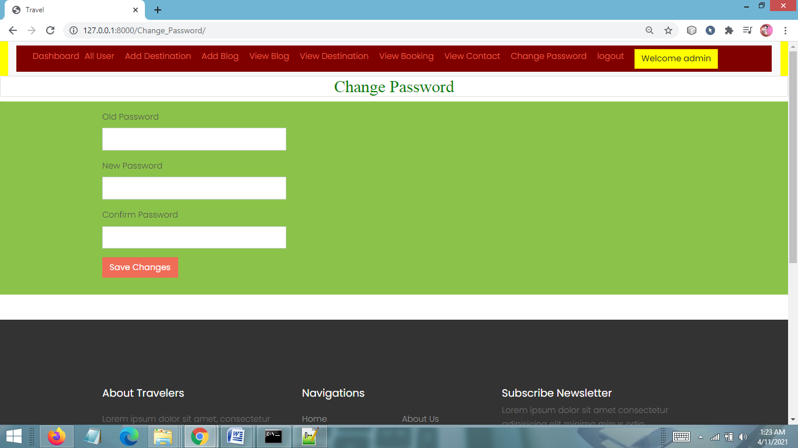
CHANGE PASSWORD PAGE

Slide 44
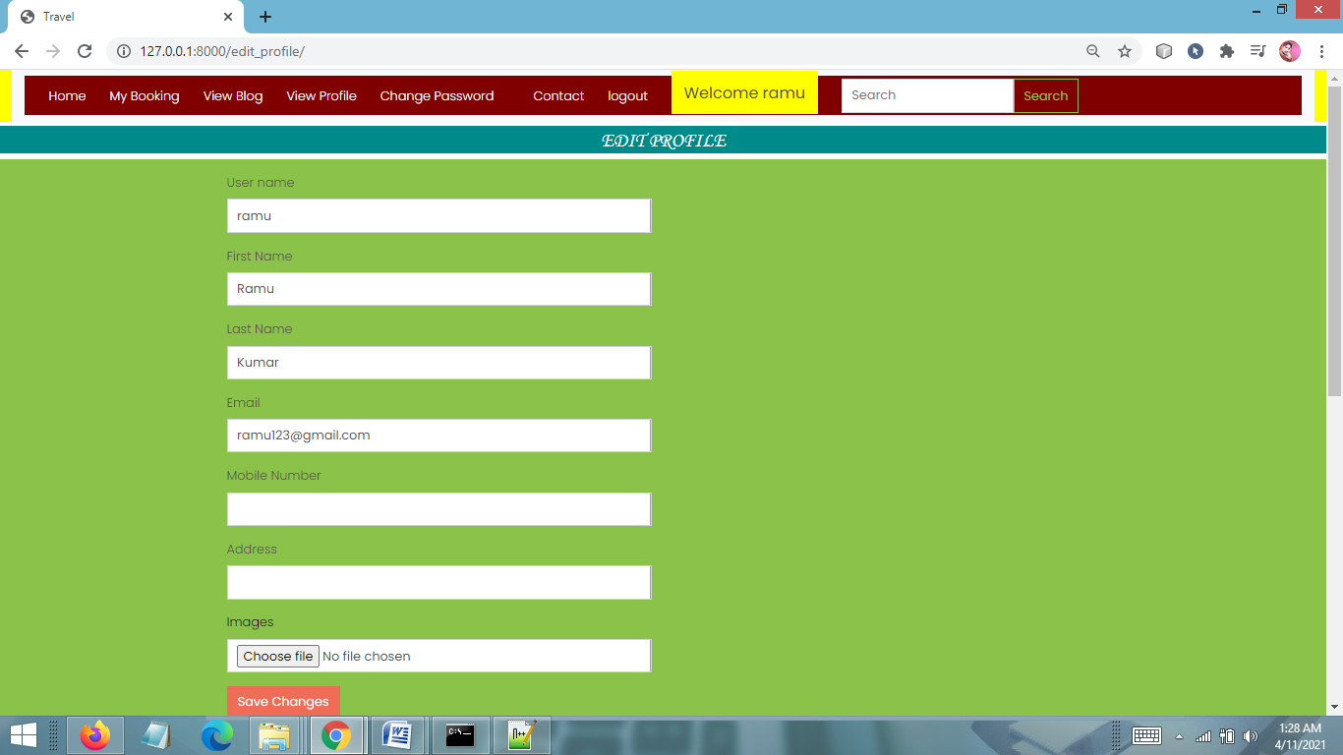
EDIT PROFILE PAGE

Slide 45
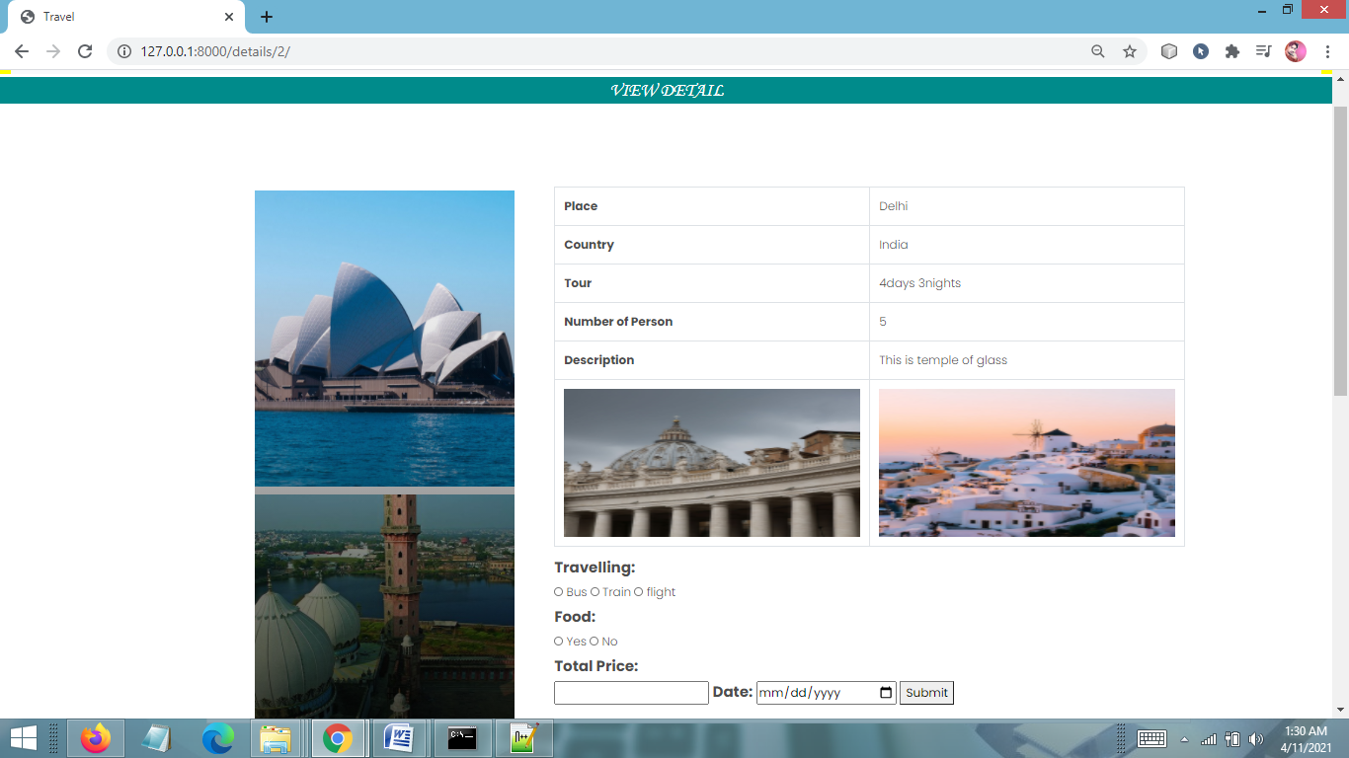
VIEW DESTINATION PACKAGE DETAIL

Slide 46
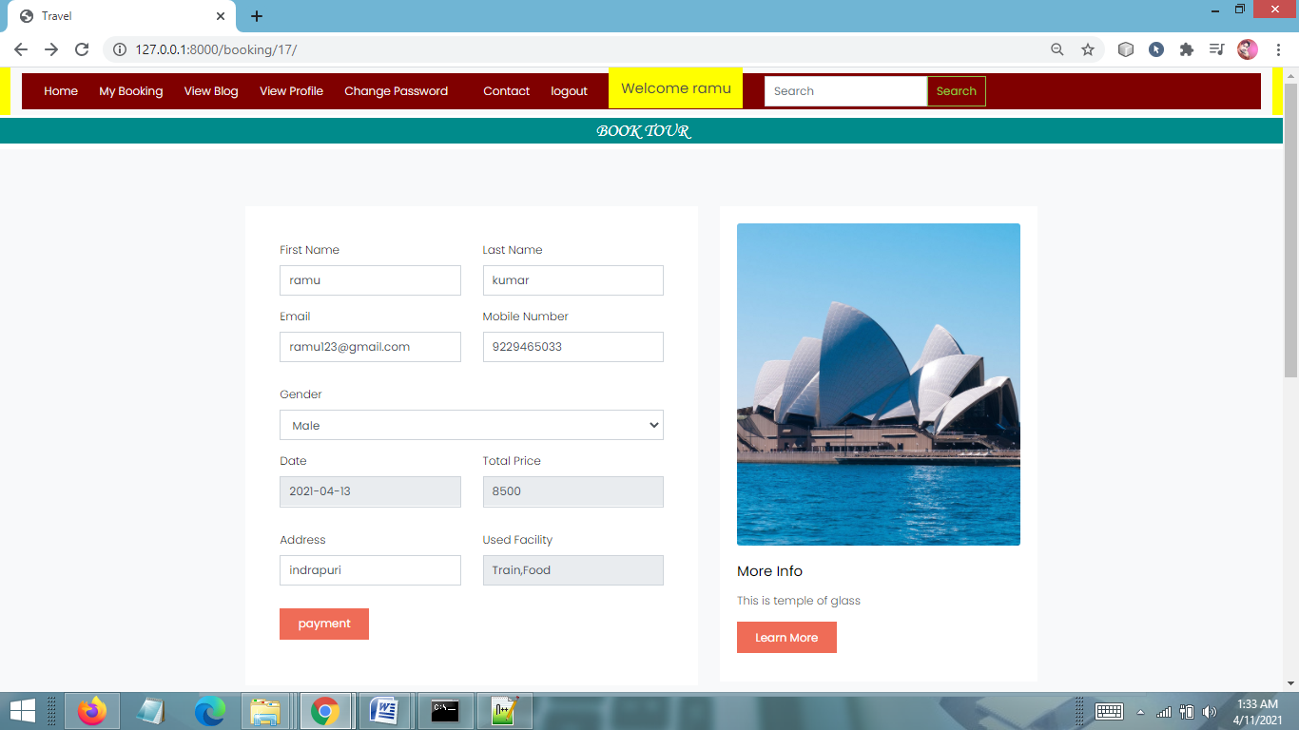
TOUR BOOKING PAGE

Slide 47
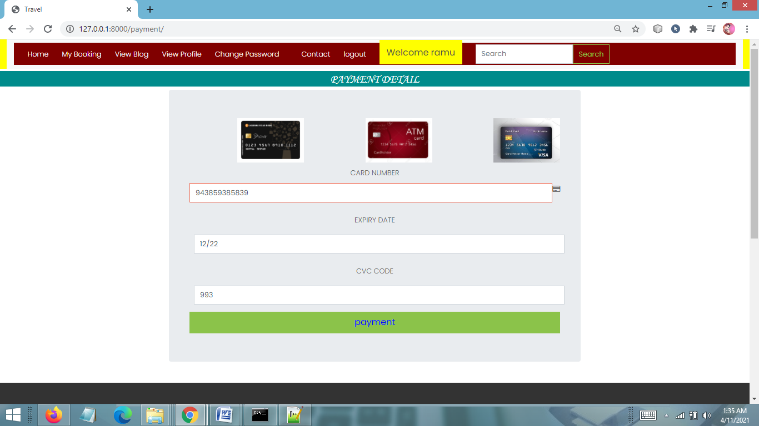
PAYMENT DETAIL PAGE

Slide 48
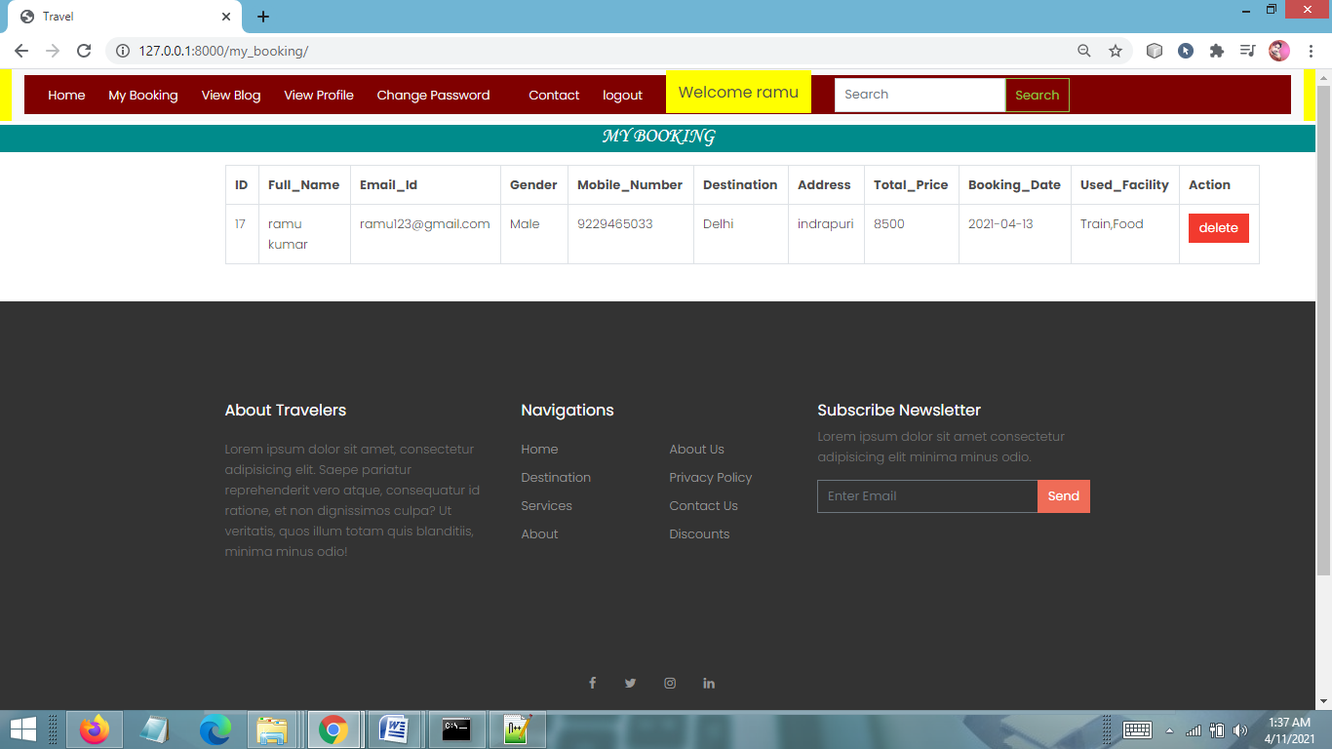
VIEW BOOKING HISTORY PAGE

Slide 49
FUTURE SCOPE
This web application involves almost all the basic features of the online tour and travel management system. The future implementation will be online help for the users and chatting with website administrator.

Slide 50
CONCLUSION
It has been a great pleasure for me to work on this exciting and challenging project. This project proved good for me as it provided practical knowledge of not only programming in PHP and MYSQL web based application. It also provides knowledge about the latest technology used in developing web enabled application and client server technology that will be great demand in future. This will provide better opportunities and guidance in future in developing projects independently.

Slide 51
BIBLIOGRAPHY
FOR PHP INSTALLATION
www.php.net
FOR DEPLOYMENT AND PACKING ON SERVER
www.developer.com
www.15seconds.com
FOR MYSQL
www.mysql.com
FOR PHP,CSS,APACHE
www.w3schools.com
www.php.net
www.cssed.sourceforge.net
www.apache.org

Slide 52
THANKYOU

